Slide 1
Frontend security
Horváth Ádám

Slide 2
Agenda
a real life example
cross-site scripting (XSS)
cross-site request forgery (CSRF)
environment variables

Slide 3
McD*s, Japan, 2019.
the app had a promotion offering free meals for customers who downloaded it
there was a weakness in the app’s frontend code that allowed a hacker to generate an unlimited number of free meal vouchers
he shared this “trick” on social media, and soon, thousands of people were generating endless free meal coupons
general chaos (staff, backend systems)
the company had to shut down the app temporarily and issue an apology

Slide 4
Cross-Site Scripting (XSS)
injection of malicious scripts when user inputs are not properly sanitized
a script entered in a blog comment field could be stored and rendered in every visitor’s browser
such scripts can access sensitive data like cookies or session tokens, leading to potential session hijacking
the attack can alter the webpage’s DOM, leading to website defacement, phishing, or redirects to malicious sites

Slide 5

Framework vulnerabilities
even big frameworks like React can be vulnerable due to
improper feature use
third-party libraries
non-standard implementations (so-called „gányolás”)

Slide 6
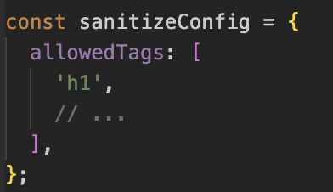
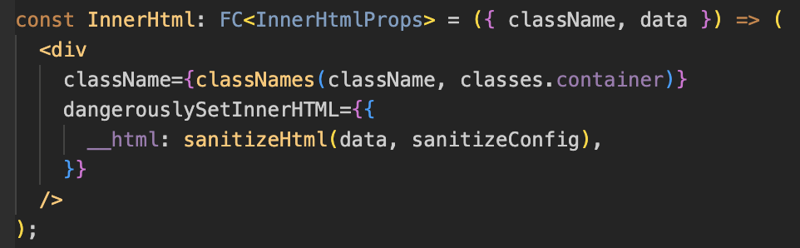
Sanitizing user input
sanitizeHtml removes any potentially malicious scripts

Slide 7
Content Security Policy (CSP)
allows you to specify which resources can be loaded and executed by the browser
it is recommended to setup CSP on the server side
# CSP Header header Content-Security-Policy "script-src 'self' 'unsafe-inline' https://maps.googleapis.com https://www.googletagmanager.com;"
self: allows scripts hosted on the same origin as the web page
unsafe-inline: allows the use of inline scripts (not recommended)
URLs: whitelisted sources allowed to run scripts
besides, style-src and img-src also exist
https://www.stackhawk.com/blog/react-content-security-policy-guide-what-it-is-and-how-to-enable-it/

Slide 8
Cross-Site Request Forgery (CSRF)
in CSRF, the attacker tricks a legitimate user into submitting a request that they did not intend to
typically done by embedding malicious requests into a website the user interacts with
exploits the fact that the user’s browser is already authenticated, and the site can’t distinguish the illegitimate request from a legitimate one
when the user clicks something on the malicious site, the hidden form is submitted to the banking site (still authenticated)

Slide 9
CSRF attack
a user logs into a banking website and their browser stores authentication cookies
the user then visits a malicious site, which contains a hidden form that triggers a fund transfer on the banking site
when the user clicks something on the malicious site, the hidden form is submitted to the banking site (still authenticated)

Slide 10
CSRF can still work with JWT
JWT in cookies
automatically sent with each request
including requests initiated by other sites
JWT in local storage or session storage
generally more resistant to CSRF
if the frontend is compromised via XSS, the attacker can access the token

Slide 11
Protection when using cookies
set the SameSite attribute on the cookie to either Strict mode
prevents the browser from sending the cookie with requests that originate from other sites
CSRF tokens
adding a CSRF token to each request can provide an extra layer of protection (generated per request by the server)
double submit cookie technique
send the same JWT in an Authorization header for each request
use short-lived tokens with refresh tokens

Slide 12
Protection when using storage
protect against XSS attacks
use short-lived tokens with refresh tokens
use double-submit CSRF tokens
you could also add a CSRF token stored in a SameSite=Strict cookie
additional security measures
e.g. rate limiting, logging activity

Slide 13
Demo
this presentation and the demo files are available at https://github.com/adam-horvath/frontend-security.git

Slide 14
Sensitive data in environment variables
even some great articles suggest to store sensitive data in environment variables
„so they don’t get leaked into the git repository”
not a secure practice and is often misunderstood or misapplied
environment variables are embedded into the JavaScript bundle during the build process
they are exposed to users

Slide 15

Thank you for your attention

